Slide 1
Module 5 Azure Virtual Network and Connectivity
Notes:
Instructor Notes
Student Notes

Slide 2

About This Module
This module focuses on enabling you to do the following:
Configure Azure Virtual Network (VNet) resources by using Windows PowerShell
Describe Azure VPN connection options, including ExpressRoute and site-to-site VPN
Configure an Azure VPN connection to an on-premises data center
Notes:
Instructor Notes
This module goes a lot less in-depth than the AWS slides. This is because since we have spent a bit of time on AWS we can obtain a comparable level of information by comparing and contrasting the services.
Student Notes

Slide 3
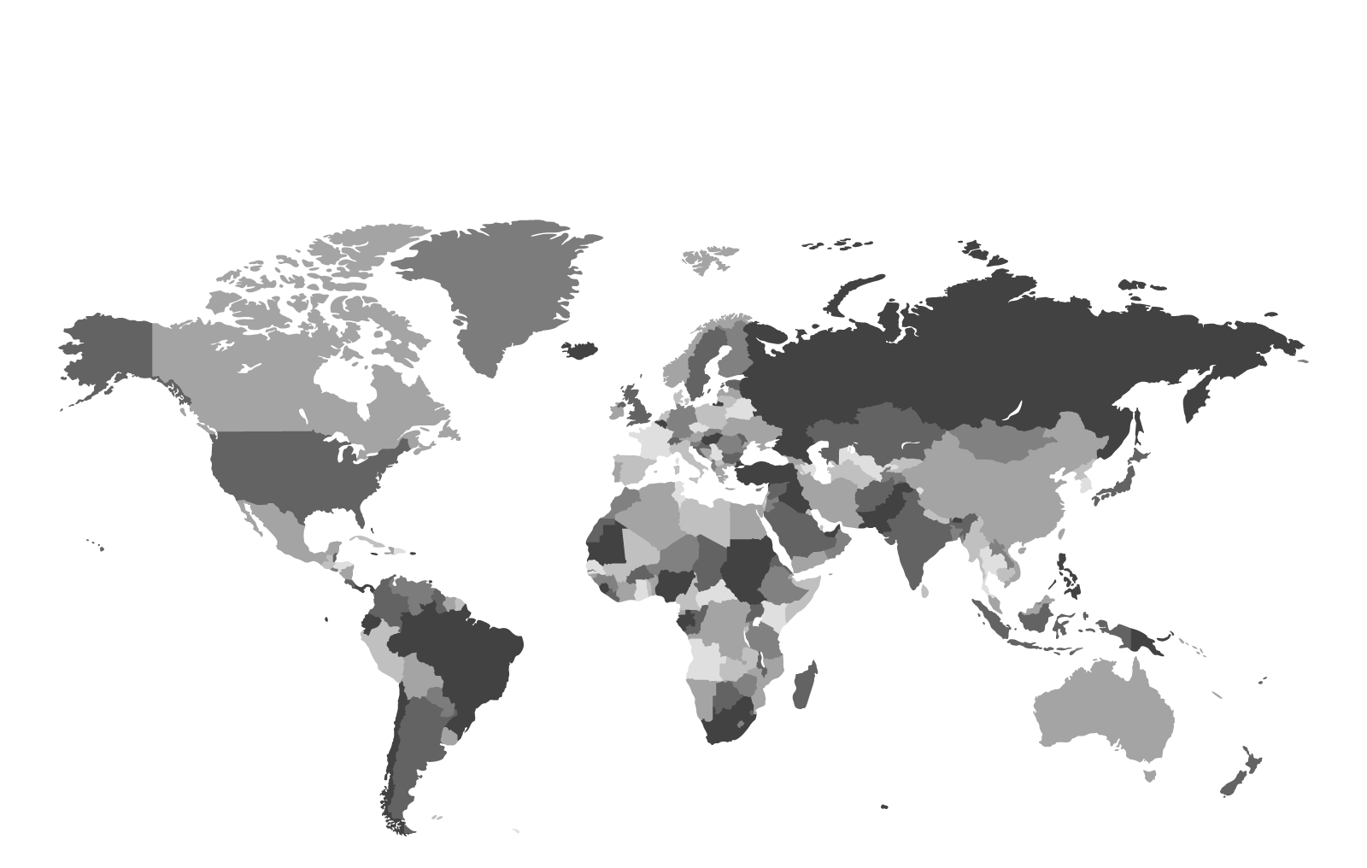
Azure: Geographies
A defined area of the world that contains at least one Azure region
China
Europe
Canada
North America
Japan
United Kingdom
US Government
Asia
India
Brazil
Australia
Notes:
Instructor Notes
Student Notes The Azure hierarchical model consists of Azure Geographies > Regions > Virtual Networks > Subnets > Applications (to include the virtual machine [VM]).

Slide 4
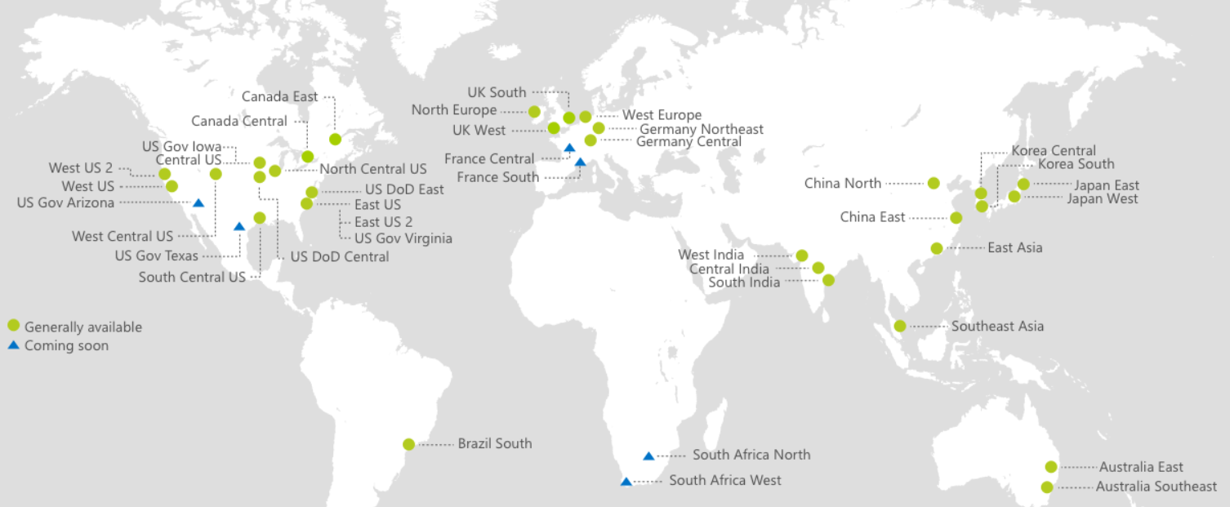
Azure: Regions
An Azure region is made up of multiple servers in data centers in a given geography, located ~300 miles (483 km) apart.
The 34 regions contain region pairs.
Notes:
Instructor Notes
What are paired regions? Azure operates in multiple geographies around the world. An Azure geography is a defined area of the world that contains at least one Azure Region. An Azure region is an area within a geography, containing one or more datacenters. Each Azure region is paired with another region within the same geography (for e.g. EAST US and WEST US), together making a regional pair. The exception is Brazil South, which is paired with a region outside its geography.
Across the region pairs Azure will serialize platform updates (planned maintenance) so that only one paired region will be updated at a time. In addition, in the event of an outage affecting multiple regions at least one region in each pair will be prioritized for recovery.
Student Notes
References:
Business continuity and disaster recovery (BCDR): Azure Paired Regions: https://docs.microsoft.com/en-us/azure/best-practices-availability-paired-regions

Slide 5
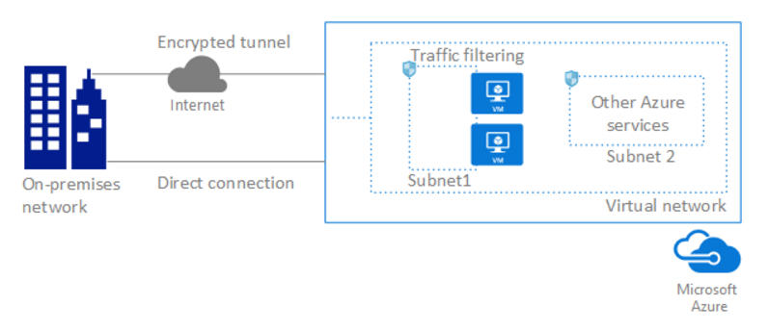
Azure: VNet
Definition
A VNet is an isolated and secure environment to run virtual machines and applications (defined by Classless Inter-Domain Routing [CIDR], it contains subnets and Network Security Groups).
You can connect VNets to your on-premises network.
Internet Protocol security (IPsec) VPN
ExpressRoute
Network traffic can be filtered inbound and outbound by source IP address and port, destination IP and port, and protocol.
Notes:
Instructor Notes
https://azure.microsoft.com/en-us/services/virtual-network/
Student Notes
A VNet is a representation of your own network in the cloud. A VNet is a logical isolation of the Azure cloud that is dedicated to your subscription. You can also connect VNets to your on-premises network.

Slide 6
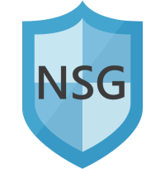

Azure: VNet
Components
Subnets
Subnets segment the network into manageable sections.
All services are available across subnets.
Network Security Groups (NSGs)
NSGs provide rules to allow or deny traffic.
NSGs are associated with subnets or network interface cards (NICs).
Front-End Subnet
Back-End Subnet
Notes:
Instructor Notes:
Front-End is equivalent to Public subnet in AWS and Back-End is equivalent to Private Subnet in AWS.
Azure uses this terminology.
Student Notes:
Subnets enable partitioning the VNet into segments for easier management. In this example, the VNet includes a public and private subnet. Public facing services like web servers can be grouped into the public subnet. Their back-end databases can be secured in the private subnet.
The network security group (NSG) is the main tool that is used to enforce and control network traffic rules by source and destination IP address, port, and protocol. Customers control access by allowing or denying communication between the workloads within a virtual network from systems in other connected networks.
https://blogs.msdn.microsoft.com/igorpag/2016/05/14/azure-network-security-groups-nsg-best-practices-and-lessons-learned/

Slide 7










Azure: VNet
Example configuration
Internet
VNet
Front-End Subnet
Back-End Subnet
Notes:
Instructor Notes Be sure to emphasize NSGs can be applied to subnets or individual network interfaces (NIC).
Student Notes:
In this example, the VNet is segmented into two subnets. A public internet facing subnet, Front-End Subnet, contains web server virtual machines. A private subnet, Back-End Subnet, contains database server virtual machines. All traffic is allowed from the VNet to the internet and within the VNet by default. No traffic is allowed from the internet directly to the subnets. NSGs contain a list of security rules that allow or deny network traffic to resources that are connected to VNets. NSGs and VNet default routes or user-defined routes (UDRs) allow internet traffic to the web servers in only the Front-End Subnet. NSGs can be applied to subnets or individual network interfaces.

Slide 8
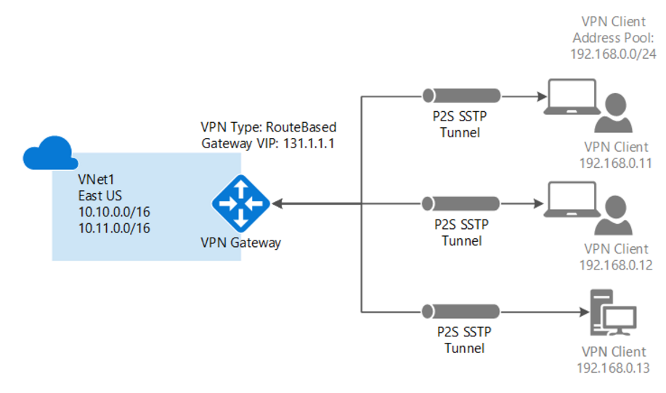
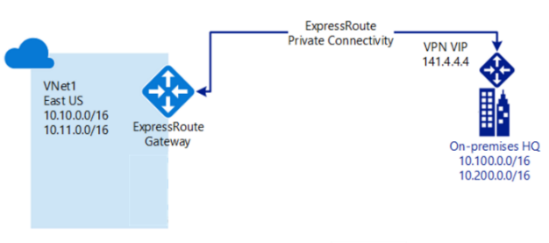
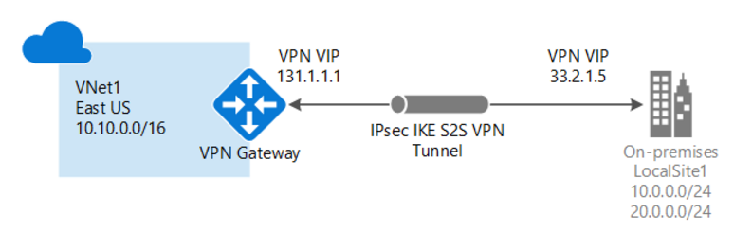

Azure Connections to On-Premises Networks
Established between a single PC and VNet
Good for experimentation or developers
Used for cross-premises and hybrid configurations
Used for the classroom lab environment
Provides a direct, dedicated connection
Is used for the NetApp Private Storage (NPS) solution
Has faster speeds, lower latencies, and higher security
Point-to-site VPN
Site-to-site VPN
Azure ExpressRoute
Notes:
Instructor Notes
Key here is to re-iterate that the lab environment uses site to site VPN but that in a true NPS deployment you must use Express Routes.
Microsoft Azure ExpressRoute lets you extend your on-premises networks into the Microsoft cloud over a dedicated private connection facilitated by a connectivity provider. Connectivity can be from an any-to-any (IP VPN) network, a point-to-point Ethernet network, or a virtual cross-connection through a connectivity provider at a co-location facility like Equinix.
ExpressRoute connections do not go over the public Internet. This allows ExpressRoute connections to offer more reliability, faster speeds, lower latencies, and higher security than typical connections over the Internet.
An ExpressRoute connection does not use a VPN gateway, although it does use a virtual network gateway as part of its required configuration. In an ExpressRoute connection, the virtual network gateway is configured with the gateway type 'ExpressRoute', rather than 'Vpn'.
Student Notes

Slide 9
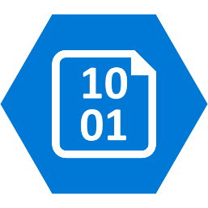
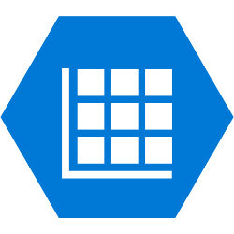


Azure Storage
Storage types
Blob Storage (Object Storage)
Stores unstructured object data
Can be any type of text or binary data (such as a document, a media file, or an application installer)
Table Storage
Stores structured datasets
Is a NoSQL key-attribute datastore
Queue Storage
Provides reliable messaging for workflow processing
Provides communication between components of cloud services
File Storage
Offers shared storage for applications that use the standard SMB protocol
Allows Azure virtual machines and cloud services to share file data through mounted shares.
Notes:
Instructor Notes
The Blob storage for the VMs used in class are VHD objects. It is also the type of storage used for AltaVault backend.
Student Notes
General-Purpose Storage Accounts
A general-purpose storage account gives you access to Azure storage services (such as tables, queues, files, blobs, and Azure Virtual Machine Disks) under a single account. This type of storage account has two performance tiers:
A standard storage performance tier which enables you to store tables, queues, files, blobs, and Azure Virtual Machine Disks
A premium storage performance tier which currently supports only Azure Virtual Machine Disks

Slide 10
Azure Storage
Storage types
Table Storage
Stores structured datasets
Is a NoSQL key-attribute datastore
Blob Storage (Object Storage)
Stores unstructured object data
Can be any type of text or binary data (such as a document, a media file, or an application installer)
File Storage
Offers shared storage for applications that use the standard SMB protocol
Allows Azure virtual machines and cloud services to share file data through mounted shares.
Queue Storage
Provides reliable messaging for workflow processing
Provides communication between components of cloud services
10
Notes:
Instructor Notes
A good explanation of all the Azure storage options is available at https://docs.microsoft.com/en-us/learn/modules/intro-to-data-in-azure/3-how-azure-storage-meets-your-business-storage-needs
Blob Storage:
Azure Blob Storage is unstructured, meaning that there are no restrictions on the kinds of data it can hold. Blobs are highly scalable and apps work with blobs in much the same way as they would work with files on a disk, such as reading and writing data. Blob Storage can manage thousands of simultaneous uploads, massive amounts of video data, constantly growing log files, and can be reached from anywhere with an internet connection.
Blobs aren't limited to common file formats. A blob could contain gigabytes of binary data streamed from a scientific instrument, an encrypted message for another application, or data in a custom format for an app you're developing. Blob storage is also used to store data for backup, disaster recovery, and archiving. It has the ability to store up to 8 TB of data for virtual machines.
Azure Queue:
Azure Queue storage is a service for storing large numbers of messages that can be accessed from anywhere in the world. To put it in perspective, a single queue message is up to 64 KB in size, and a queue can contain millions of messages.
Typically, there are one or more sender components and one or more receiver components. Sender components add messages to the queue, while receiver components retrieve messages from the front of the queue for processing.
Azure Files:
Azure Files offers fully managed file shares in the cloud that are accessible via the industry standard Server Message Block (SMB) protocol. Azure file shares can be mounted concurrently by cloud or on-premises deployments of Windows, Linux, and macOS. Applications running in Azure virtual machines or cloud services can mount a file storage share to access file data, just as a desktop application would mount a typical SMB share. Any number of Azure virtual machines or roles can mount and access the file storage share simultaneously. Typical usage scenarios would be to share files anywhere in the world, diagnostic data, or application data sharing.
Azure Table Storage: https://docs.microsoft.com/en-us/azure/cosmos-db/table-storage-overview (A premium offering of Table Storage is available as Azure Cosmos DB)
Azure Table storage is a service that stores large amounts of structured NoSQL data in the cloud, providing a key/attribute store with a schemaless design. Because Table storage is schemaless, it's easy to adapt your data as the needs of your application evolve. Access to Table storage data is fast and cost-effective for many types of applications, and is typically lower in cost than traditional SQL for similar volumes of data.
You can use Table storage to store flexible datasets like user data for web applications, address books, device information, or other types of metadata your service requires. You can store any number of entities in a table, and a storage account may contain any number of tables, up to the capacity limit of the storage account.
Azure SQL Database:
Azure SQL Database is a relational database as a service (DaaS) based on the latest stable version of the Microsoft SQL Server database engine.
Azure Data Lake Storage Gen 2
A data lake is a repository for large quantities and varieties of both structured and unstructured data in their native formats. Data lake eliminates all the restrictions of a typical data warehouse system by providing unlimited space, unrestricted file size, schema on read, and various ways to access data (including programming, SQL-like queries, and REST calls).
The Data Lake feature allows you to perform analytics on your data usage and prepare reports.
Azure Data Lake can, broadly, be divided into three parts:
Azure Data Lake store - Azure Data Lake Storage Gen2 combines the scalability and cost benefits of object storage with the reliability and performance of the Big Data file system capabilities.
Azure Data Lake analytics
Azure HDInsight
Disk Storage:
Disk storage provides disks for virtual machines, applications, and other services to access and use as they need, similar to how they would in on-premises scenarios. Disk storage allows data to be persistently stored and accessed from an attached virtual hard disk. The disks can be managed or unmanaged by Azure, and therefore managed and configured by the user. Typical scenarios for using disk storage are if you want to lift and shift applications that read and write data to persistent disks, or if you are storing data that is not required to be accessed from outside the virtual machine to which the disk is attached.
Disks for VMs go under a generic Azure created Storage account.
Student Notes
General-Purpose Storage Accounts
A general-purpose storage account gives you access to Azure storage services (such as tables, queues, files, blobs, and Azure Virtual Machine Disks) under a single account. This type of storage account has two performance tiers:
A standard storage performance tier which enables you to store tables, queues, files, blobs, and Azure Virtual Machine Disks
A premium storage performance tier which currently supports only Azure Virtual Machine Disks

Slide 11
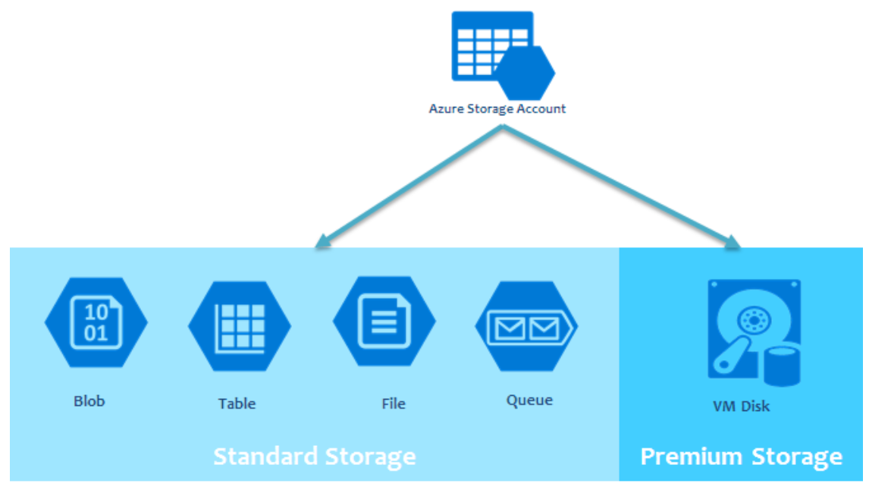
Azure Storage Accounts
An Azure storage account contains all of your Azure Storage data objects:
blobs
files
queues
tables
disks
Data in your Azure storage account is
durable and highly available
Secure
massively scalable
accessible from anywhere in the world over HTTP or HTTPS
Notes:
Instructor Notes
Types of Storage Accounts: https://docs.microsoft.com/en-us/azure/storage/common/storage-account-overview#types-of-storage-accounts
General-purpose v2 accounts: Basic storage account type for blobs, files, queues, and tables. Recommended for most scenarios using Azure Storage.
General-purpose v1 accounts: Legacy account type for blobs, files, queues, and tables. Use general-purpose v2 accounts instead when possible.
Blob storage accounts: Blob-only storage accounts. Use general-purpose v2 accounts instead when possible.
Microsoft recommends using a general-purpose v2 storage account for most scenarios. You can easily upgrade a general-purpose v1 or Blob storage account to a general-purpose v2 account with no downtime and without the need to copy data.
General-purpose storage accounts may be configured for either of the following performance tiers:
A standard performance tier for storing blobs, files, tables, queues, and Azure virtual machine disks.
A premium performance tier for storing Azure virtual machine disks only.
Disks are under Azure created Storage account. For all other storage types you want to use, you first create a storage account and select its characteristics like the redundancy options, performance.
By default all storage under the storage account will be encrypted using Azure managed keys. You can override and provide your own key to do encryption.

Slide 12
Storage Durability and Availability
Replication Options
Zone 1
Zone 2
Zone 3
Typically >300mi
Typically >300mi
Async
Async
ZRS
3 replicas across 3 Zones
Protect against disk, node, rack and zone failures
Synchronous writes to all 3 zones
Generally Available now in 6 regions
Primary
Secondary
Primary
Secondary
LRS
3 replicas, 1 region
Protect against disk, node, rack failures
Write is ack’d when all replicas are committed
GRS
6 replicas, 2 regions (3/region)
Protects against major regional disasters
Asynchronous to secondary
RA-GRS
GRS + Read access to secondary
Separate secondary endpoint
RPO delay to secondary can be queried
Notes:
Instructor Notes
ZRS:
US East 2, US Central, N EU, W EU, France Central, SE Asia
GPV2
https://docs.microsoft.com/en-us/azure/storage/common/storage-account-overview#replication
Data durability and availability are made possible for the storage accounts with the following replication options:
Locally-redundant storage (LRS): A simple, low-cost replication strategy. Data is replicated within a single storage scale unit.
Zone-redundant storage (ZRS): Replication for high availability and durability. Data is replicated synchronously across three availability zones.
Geo-redundant storage (GRS): Cross-regional replication to protect against region-wide unavailability.
Read-access geo-redundant storage (RA-GRS): Cross-regional replication with read access to the replica.

Slide 13
AWS Versus Azure
Feature comparison
AWS
EBS
Amazon S3
RDS
Glacier
DynamoDB, EMR, Kinesis, Redshift
VPC
Route 53
Amazon CloudFront
Feature
Block Storage
Object Storage
Relational Database (DB)
Archiving
NoSQL and Big Data
Virtual Network
DNS
Content Delivery Network (CDN)
Azure
Page Blobs
Block Blobs and Files
Relational DBs
Blobs (cool storage tier)
Windows Azure Table, HDInsight
VNet
Azure DNS
Azure CDN
AWS: Amazon Web Services |. EBS: Amazon Elastic Block Store |. Amazon S3: Amazon Simple Storage Service RDS: Amazon Relational Database Service | VPC: Virtual Private Cloud
Notes:
Instructor Notes Note each hyperscaler has their own unique way of implementing architectures and services, so there is not a one to one mapping, but some concepts are similar across both.
Student Notes

Slide 14
AWS Versus Azure
Further feature comparison
AWS
Amazon Elastic Compute Cloud (Amazon EC2), Amazon Elastic Beanstalk
Auto Scaling
Elastic Load Balancing
Feature
Compute Services
Scaling
Load Balancing
Azure
Virtual Machines, Cloud Services, Azure Websites and Applications, Azure Visual Studio Online
Azure Autoscale
Load Balancer Application Gateway
See the latest comparison of the top four cloud providers: http://cloudcomparison.rightscale.com/
Notes:
Instructor Notes
Student Notes

Slide 15


Hands-On Activity
Module 5: Azure Virtual Network and Connectivity
Exercise 1:
Configuring Azure Virtual Network to On-Premises VPN Connectivity
This exercise requires approximately 1 hour.
Notes:
Instructor Notes
Now you are ready to create an Azure Account to use for this course.

Slide 16

ACTION: Share Your Experiences
Roundtable questions for the exercise
What was the purpose of the gateway subnet that you created in the VNet?
Are there any limitations on the shared key that was created?
What type of storage is used for the virtual machine that you launched?
16
Notes:
Instructor Notes
Question 1: This is a specially named Subnet that is used as the connection point into the subnet. Note that it has to be named “GatewaySubnet” to function correctly. This is similar in functionality to the VGW that you created in AWS.
Question 2: The SharedKey can be any value, the key is that it is the same value on the Azure and on-prem side.
Question 3: Could have students go check if no one knows, it uses Blob storage (VHD).
Student Notes
If you encounter an issue, notify your instructor immediately so that it can be resolved promptly.

Slide 17

More Azure Training
Cloud Volumes ONTAP
Self-paced vClassroom course: “Cloud Volumes ONTAP Deployment and Management for Azure”
Deeplink: http://learningcenter.netapp.com/LC?ObjectType=WBT&ObjectID=00369436

Slide 18
Module Review
This module focused on enabling you to do the following:
Create a VNet, subnet gateway, and VPN connection by using PowerShell scripts and verified connectivity between the on-premises data center and the VNet
Compare Azure resources and features to similar AWS entities
Notes:
Instructor Notes
Student Notes

